Slide 1
Board of Commissioners Work Session
January 19, 2016

Slide 2
Agenda
Introduction
CTP purpose and goals
CTP development overview
Project prioritization process
Funding
Recommended projects / investments
Next Steps

Slide 3
Project Team
Parsons Brinckerhoff (PB)
Metro Planning and Engineering, Inc. (MPE)
Travel Demand Modeling
Transit
Sycamore Consulting, Inc. (SCI)
Stakeholder and Public Involvement
County Project Manager
Geoffrey E. Morton, P.E., Public Works Agency Director

Slide 4
CTP Purpose
Re-evaluation of the 2008 CTP vision, goals, objectives, and investment strategies
Update existing and future needs based on current conditions
Identify potential solutions, with a focus on innovative, less costly options
Develop funding strategy and prioritize future SPLOST projects

Slide 5
Plan Development Process
Existing Conditions
Needs Assessment
Comprehensive Project List
Previous Plans
Stakeholder Meetings
Public Comments
Needs based
Data
Cost Estimate
Traffic/Demand
Goals
Statistical Data
Prioritization Methodology
Funding
Compare Results
Identify Funding Sources
Balance
Allocate Funding
Recommended Projects

Slide 6
Population Overview
Between 1980 and 2010 the County grew by 315%
Current Profile
Density concentrated in southern half
Fewer youth, minorities and low income households than metro and statewide averages
More seniors than metro average
Projected Population Growth
94% increase in total population through 2040
Continued strong growth, but at a slower rate, highest rate of growth from 2010-2020
Increasing share of regional population

Slide 7
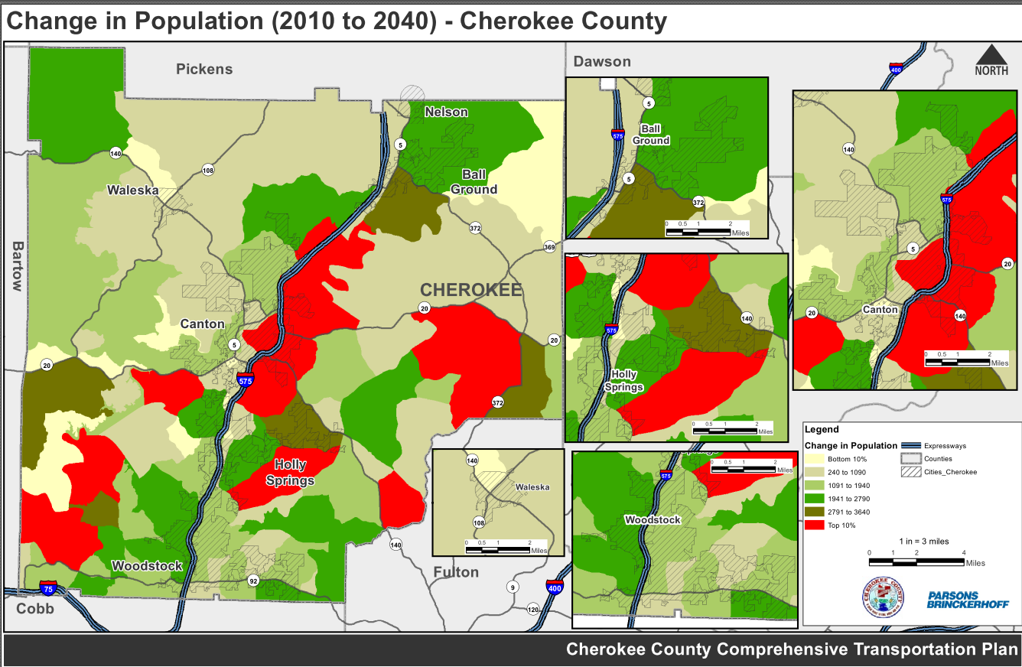
Projected Population Change (2010-2040)
Notes:
In absolute terms, the following areas are projected to house a significant number of new Cherokee residents:
Central section of the county near Canton on the eastside of the I-575 corridor
Eastern section of the county near the Fulton/Forsyth County lines
Southwest section of the county near the Cobb/Bartow County lines
Holly Springs

Slide 8
Employment Overview
Low unemployment rate relative to region and state
Industry Mix
Higher proportion of goods-producing jobs, mainly Construction and Manufacturing
Lower proportion of service-producing jobs, significant employment in Retail Trade
Projected Employment Growth
166% increase in employment through 2040
Increased share of regional employment
Significant growth in high paying sectors

Slide 9
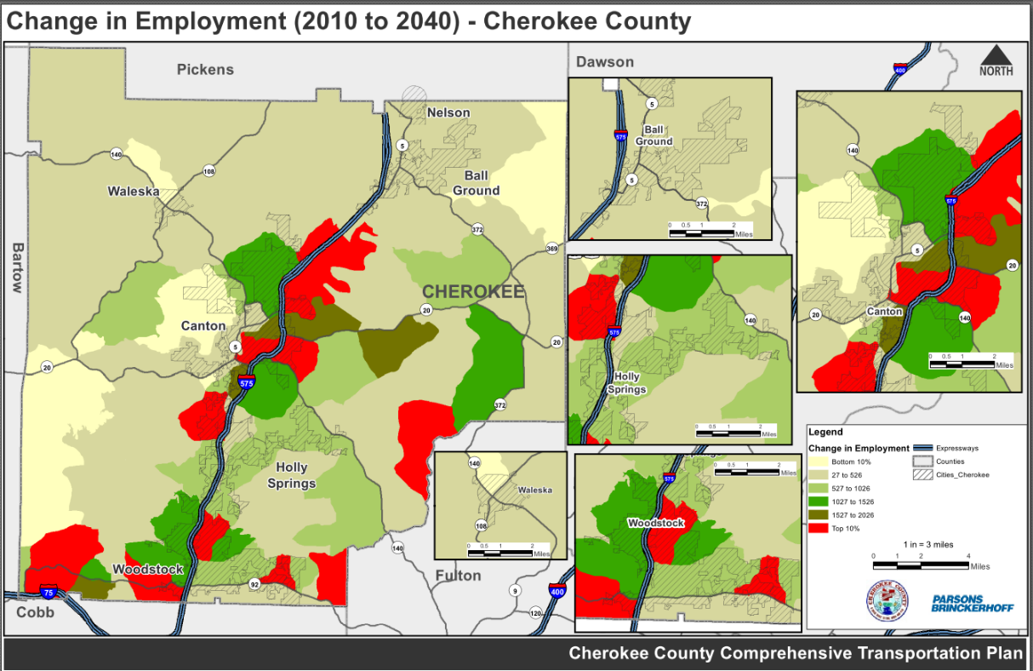
Projected Employment Change (2010-2040)
Notes:
In absolute terms, the majority of jobs will be added along the central section of the I-575 corridor near Canton and the airport, as well as along SR-92 near Cobb and Fulton counties in Woodstock.

Slide 10
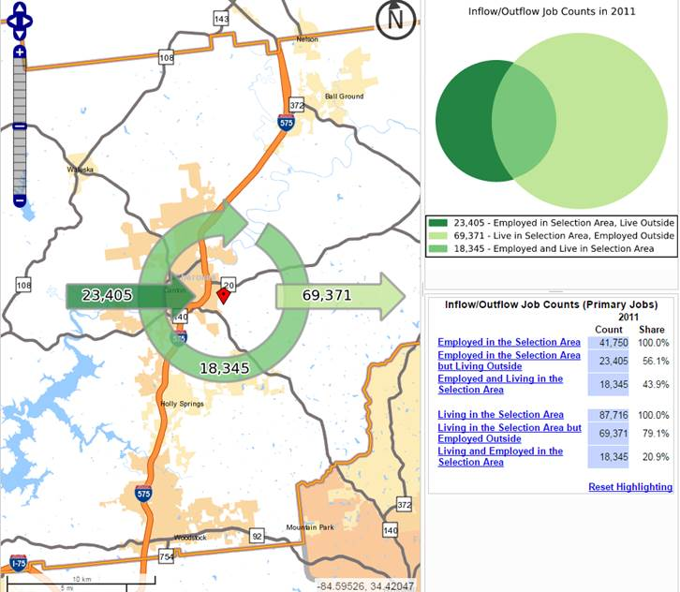
Commuting Patterns

Slide 11
CTP Goals
Ensure public safety
Increase accessibility and connectivity
Improve mobility and efficiency
Support multiple modes of transportation
Enhance quality of life & health
Identify and enhance key freight routes
Minimize environmental impacts
Preserve and maintain existing transportation facilities
Engage in effective public engagement strategies

Slide 12
Public Outreach
2 Rounds of Public Meetings
March 2015
96 Attendees
Database of 300 Stakeholders
62 comments
33 written/29 online
June 2015
89 Attendees
Database of 479 Stakeholders
201 comments
46 written/155 online

Slide 13
Public Meetings
“If you had $10 million dollars to spend on transportation …”

Slide 14
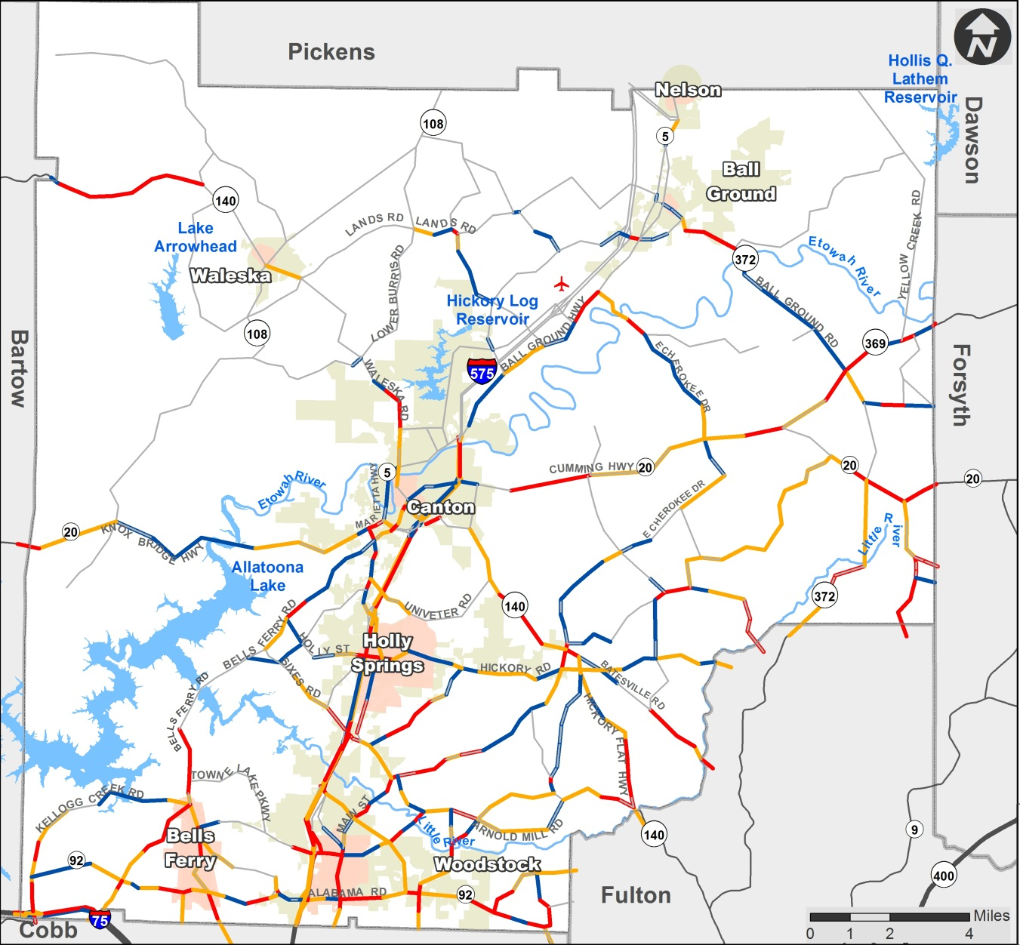
2040 Levels of Service – Existing plus Committed System
Notes:
Reference network deficiencies / needs assessment

Slide 15
Types of Roadway Solutions
Capacity Improvements
Roadway construction
Roadway widening
Operational improvements
Signal timing and signage
Geometric improvements
Traffic calming
Roadway geometrics
Traffic signal interconnection
Intersection Improvements
Turn lanes
Signalization
Roundabouts
Safety Projects and Bridge Improvements

Slide 16
Multi-Modal Solutions
Transit
Sustainable Implementation Plan
Bicycle / Pedestrian and Multi-Use Trails
Complete Streets
Conceptual Trail Plan

Slide 17
Project Prioritization
Based on CTP Goals and Feedback
Key Factors in Project Prioritization
Congestion Relief
Safety Resolution
Cost-Benefit Ratio
Economic Development Potential
Compatibility with Adjacent Areas
Deliverability

Slide 18
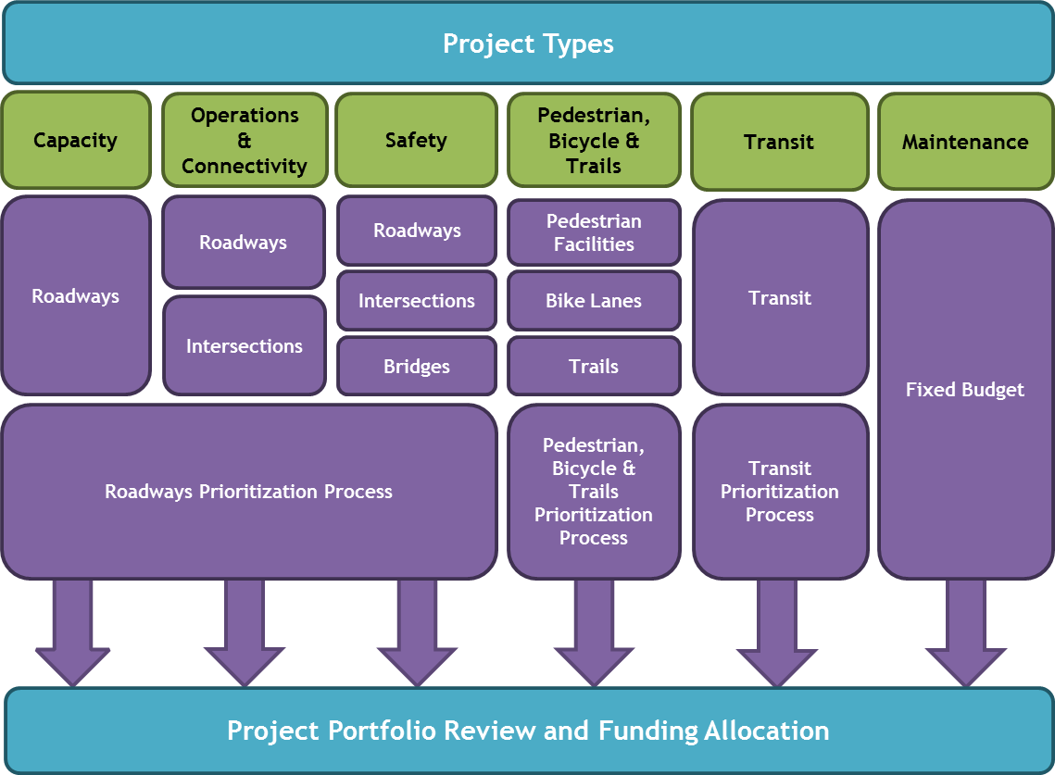
Project Prioritization Process
Notes:
What is the basis for tiering?

Slide 19
Initial Funding Targets
Widen Congested Roads
Construct New Roads
Intersection & Corridor Improvements
Modify Signal
Add Turn Lane
Roundabouts
Resurface Existing Roadway
Maintain Bridge with Sufficient Rating
Maintain Trail
Capacity
25%
Operations
& Connectivity
15%
Maintenance
20%
$138 M
$83 M
$110 M
Safety
Transit
Pedestrian,
Bicycle & Trails
15%
10%
15%
Improve High Crash Intersection or Roadway
Modify or Rebuild Bridge with Low Rating
Signalize Rail Crossings
Extend CATS System – Routes, Buses, Hours
Develop Additional GRTA Xpress Bus and Park-n-Ride Lots
New / Upgraded Pedestrian Facilities
New / Extended Trails
New Bike Lanes
$83 M
$55 M
$83 M

Slide 20
Funding
Anticipated SPLOST Funding - $516 million
SPLOST 2019-2024: $100 million
SPLOST 2025-2030: $130 million
SPLOST 2031-2040: $286 million
Anticipated GDOT Funding (LMIG) - $40 million
$1.6 million per year for 25 years
Funding Approach
Federally funded – 20% local match funding
Consider state/federal dollars on state highway system; larger more complex projects
SPLOST on local street system; smaller, simpler projects
SPLOST to leverage state/federal funding as appropriate
State Route/Interstate projects must compete regionally (ARC)
Notes:
LMIG – mainly resurfacing

Slide 21
Sources of Funding (2015 – 2040)
*Does not represent a complete list of projects to be funded through HB 170
Notes:
RTP:
Federal: $252 million
State: $279 million
SPLOST:
2019-2024: $100 million
2025-2030: $130 million
2031-2036: $286 million
HB 170 – this does not represent any funding from that. That question will come up – especially from the Chairman since GDOT announced that SR 20 between 575 and Cumming will be state funded. However, I know that GDOT has not yet released any project lists or funding estimates on state funded project. We may want to put a caveat for that on the bottom of this slide.

Slide 22
Funding Allocation – Recommended Projects
*Unconstrained list, Federal/State/Local Sources
Notes:
*For projects funded through sources other than SPLOST, the idea was to proposed a recommended tiers for such projects so that County can make appropriate suggestions to ARC/Cities. As a result, it is not balanced to the current amount allocated in the RTP.
Total number – not truly constrained - Total

Slide 23
Funding Allocation - SPLOST
Notes:
Some of the unallocated funding from Operations and Safety was later allocated to Capacity projects.
Total number – $347.3 million
Project type: Allocated amount (Initial target)-
Capacity Expansion: $192 million ($138 million)
Operations & Connectivity: $33 million ($83 million)
Safety & Bridge Upgrades: $40 million ($83 million)
Bicycle-Pedestrian Facilities: $81 million ($83 million)
Transit: $66.5 thousand ($55 million)

Slide 24
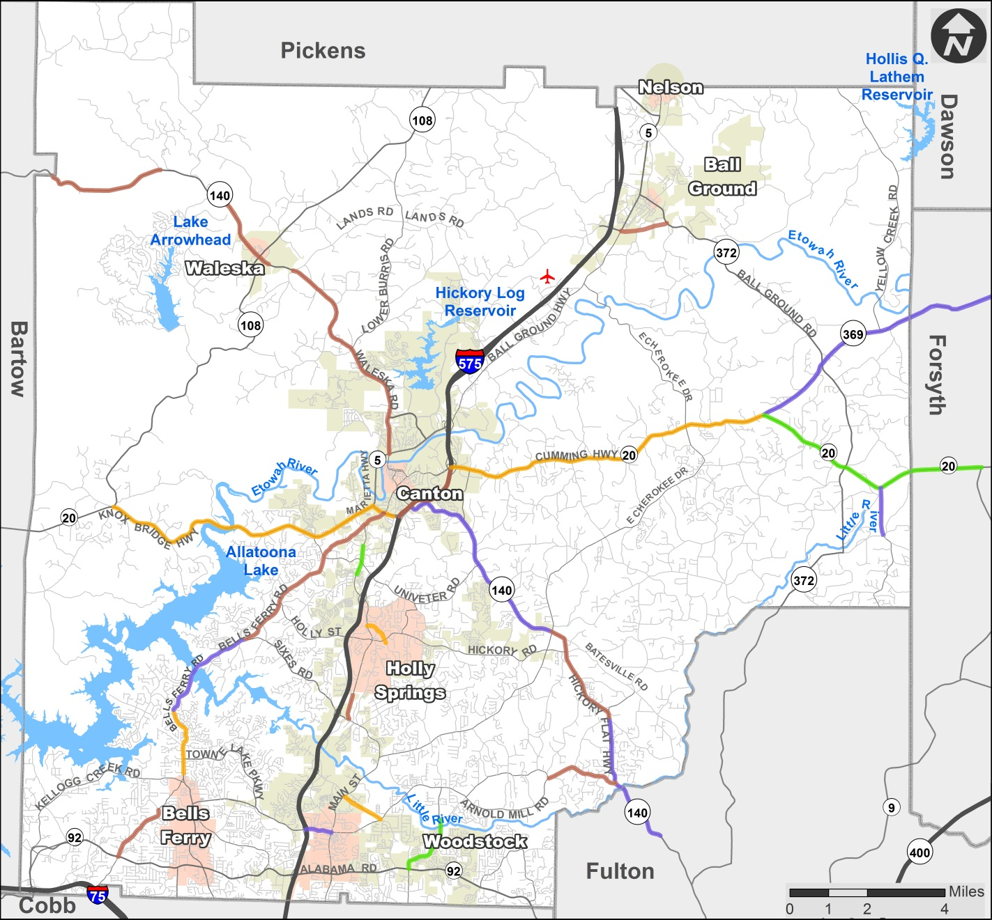
Capacity Expansion Projects
Notes:
SR 20 Phases – Tier 0
Fincher Road to 575
575 to Scott Road
Scott Road to SR 369
SR 369 to SR 371 – Tier 1

Slide 25
Capacity Expansion Projects – Tier 1
Name | Location
SR-20 (Cumming Highway) Widening | SR 369 to SR 371
Marietta Hwy Widening | From Ridge Pine Dr/Pine Crest Dr to Ridge Rd/Canterbury Ridge Pkwy
Trickum Rd Widening | From Barnes Rd to SR-92
Notes:
SR 20 widening for Fincher Road to I-575, I-575 to Scott Rd and Scott Rd to SR 369 is in tier 0 as per the RTP (Region’s Plan).

Slide 26
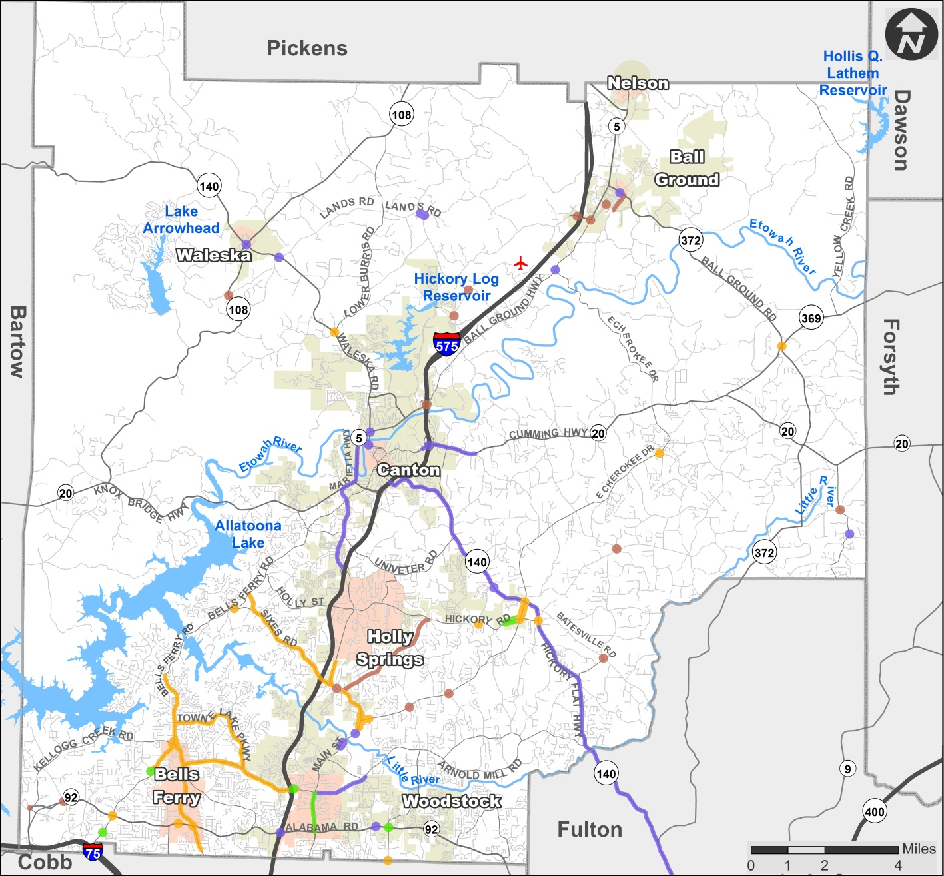
Operations & Connectivity Projects

Slide 27
Operations & Connectivity Projects– Tier 1
Name | Location
Main St Corridor Improvements | From Towne Lake Pkwy/Arnold Mill Rd to SR-92
I-575 @ Towne Lake Parkway Interchange Improvement | At Towne Lake Parkway
SR-92 @ Trickum Rd Intersection Improvement | At Trickum Rd
Woodstock Rd @ Victory Dr Roundabout | At Victory Dr

Slide 28
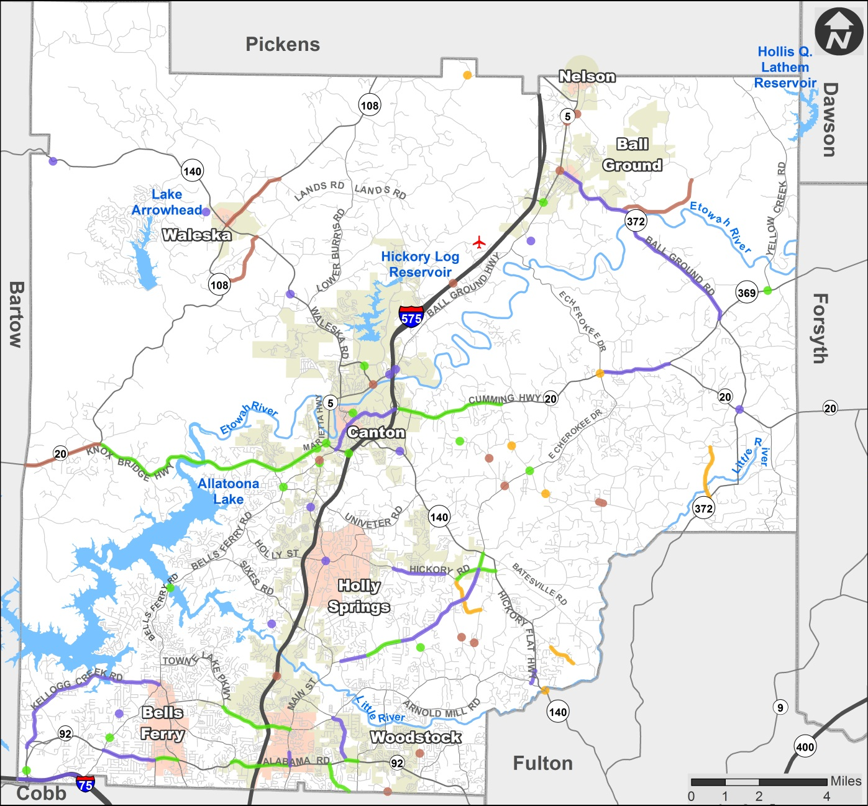
Safety Improvements and Bridge Upgrades

Slide 29
Safety Improvements and Bridge Upgrades – Tier 1
Name | Location
SR-20 Safety Improvements | From SR-5 @ SR-140 to Etowah River
Safety Improvements on SR 92 | From Wade Green Rd NW to Bells Ferry Rd
SR-20 Safety Improvements | From Union Hill Rd to I-575
Safety Improvements on SR 92 | From Bascomb Carmel Rd to Main St
Safety Improvements on Arnold Mill Rd | From Towne Lake Pkwy to Main St
Safety Improvements on SR 92 | From Neese Rd to Trickum Rd
Safety Improvements on Hickory Rd | From Little Rd to SR 140
Safety Improvements on E Cherokee Dr | From Hickory Rd to SR 140
Safety Improvements typically include enhancements such as roadway realignment, traffic calming, turn lanes, rebuilding intersections etc.
Notes:
What are these?
Safety improvements – what does that mean? Need to define safety improvement – is it turn lanes, striping, signage etc??
-As many of these projects were added based on number of crashes/fatalities, we do not have exact details for these projects. However, Safety Improvements can indicate enhancements such as rebuilding intersections, roadway realignment, turn lanes etc. I have added a text box to the slides to explain that.
Note that a lot of the safety improvements in Tier 1 overlap the capacity projects in Tier 1 – are we allocating funds there correctly or are we double allocating funds??
-A lot of those Capacity projects appear in tier 1 as their ROW or PE phases are recommended to be in tier 1. However, actual construction is expected to take place later. As a result, we decided to double count the allocation of funds to such projects. I think most of such projects are on SR 20.

Slide 30
Safety Improvements and Bridge Upgrades – Tier 1
Name | Location
Hames Rd - South Jett Rd Realignment | From SR 92 to Jamerson Rd
E Cherokee Dr Safety Improvements - II | From S Sequoyah Dr to Ranchwood Trl
SR-20 Safety Improvements | From SR 108 to west of Knox Bridge Rd
SR-20 @ SR-5 @ Marietta Rd @ SR-140 Safety Improvement | At SR-5
I-575 and Hickory Flat Hwy Interchange | At Hickory Flat Hwy
Safety Improvements on E Main St @ Brown St @ North St | At Brown St @ North St
Safety Improvements on SR 92 @ North Point Pkwy | At North Dr
Bells Ferry Rd and Butterworth Rd | At Bells Ferry Rd
Safety Improvements typically include enhancements such as roadway realignment, traffic calming, turn lanes, rebuilding intersections etc.

Slide 31
Safety Improvements and Bridge Upgrades– Tier 1
Name | Location
Howell Bridge Rd @ Ball Ground Hwy Safety Improvement | At Ball Ground Hwy
Safety Improvements on Reinhardt College Pkwy @ Riverstone Blvd | At Riverstone Blvd
Union Hill Rd and E Cherokee Dr | At Union Hill Rd
Woodstock Rd Culvert Replacement | At North of Sable Trace
SR-369 (Hightower Road) Bridge Replacement | At Board Tree Creek
Bells Ferry Road Bridge Replacement | At Little River
Tripp Rd Bridge Replacement | At Mill Creek
Epperson Rd Bridge Replacement - North (Henson Rd) | At Canton Creek
Safety Improvements typically include enhancements such as roadway realignment, traffic calming, turn lanes, rebuilding intersections etc.
Notes:
Ditto from slides 17 and 18.

Slide 32
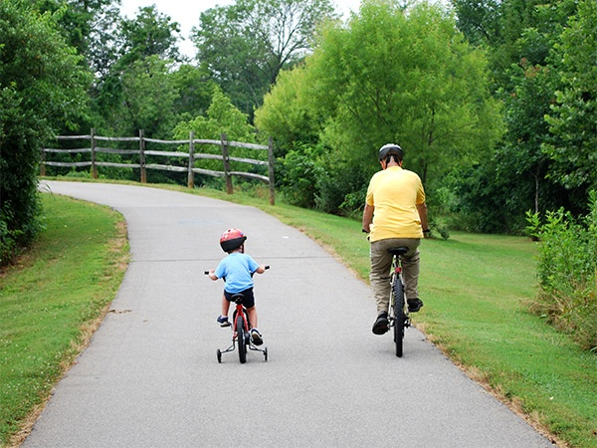
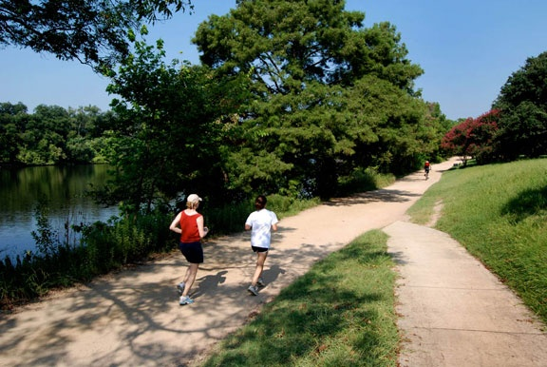
Conceptual Trail Planning
Develop Connectivity and Alignment
Data from current and prior trail planning efforts
Information on publicly controlled land
Identify potential destinations and connectivity needs
Prepare conceptual alignments
Detailed planning efforts to be led by Parks and Recreation in subsequent study
PHOTO: Salisbury, NC Greenway

Slide 33
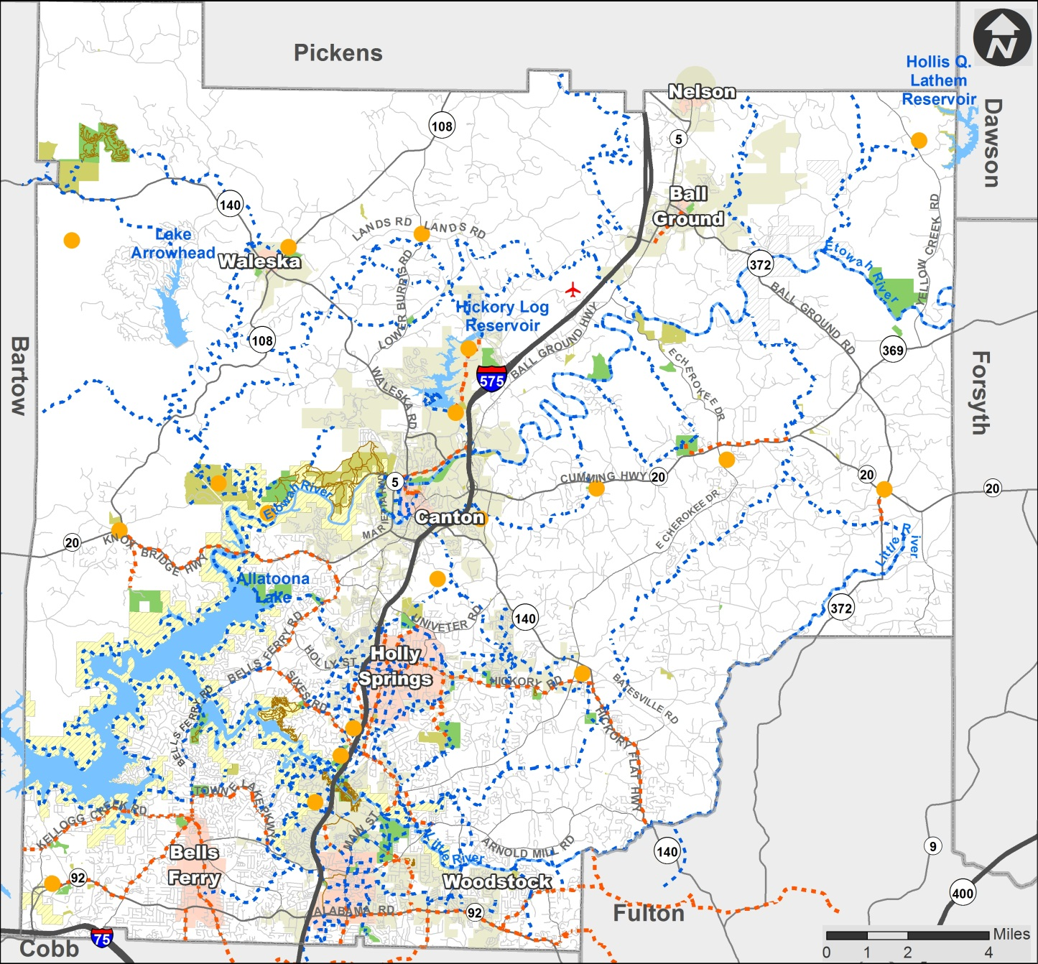
Potential Trail Projects

Slide 34
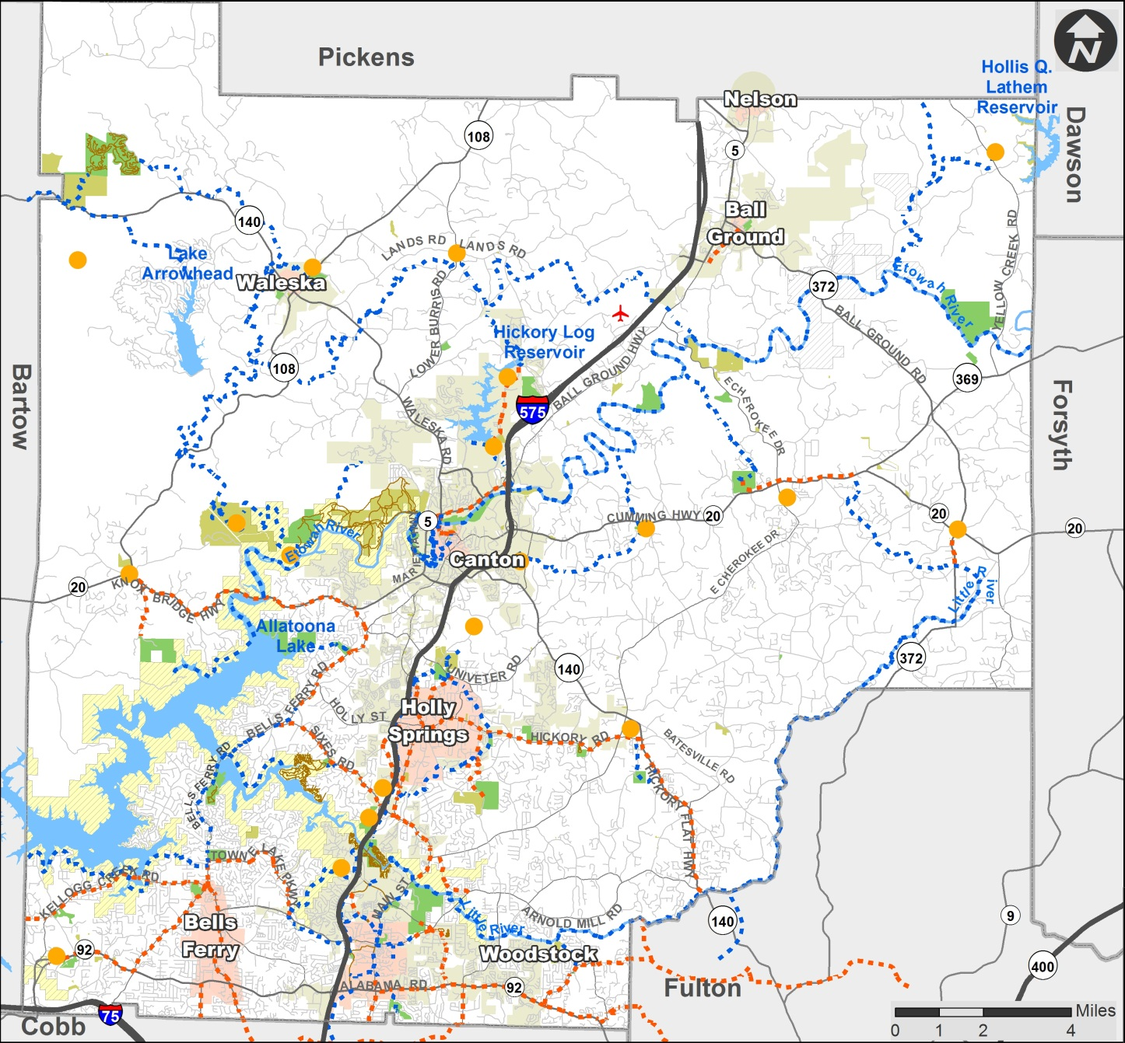
Proposed Trails

Slide 35
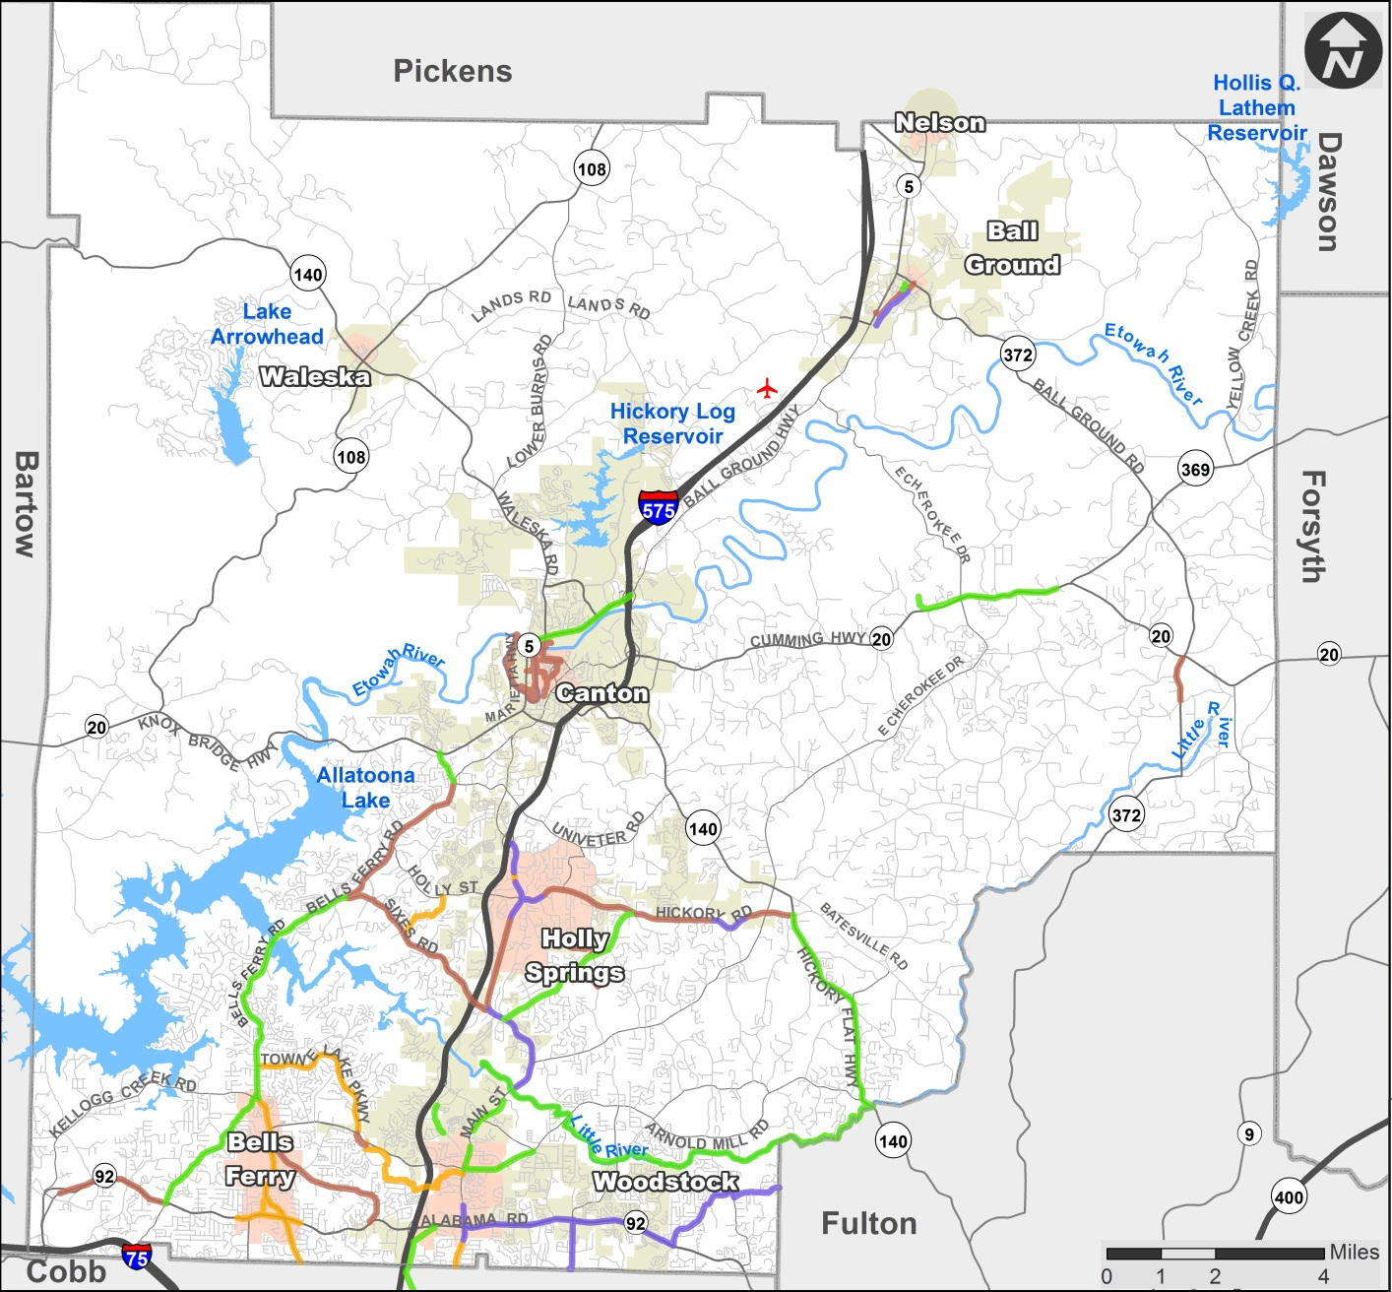
Bike / Ped Facilities
Notes:
Check your airport legend symbol on this one!

Slide 36
Bike / Ped Facilities– Tier 1
Name | Limits
Arnold Mill Rd Sidewalks | From Main St to Neese Rd
Bells Ferry Rd | From Kellogg Creek Rd to Sixes Rd
Butterworth Rd | From Bells Ferry Rd to SR 20
J.J. Biello - Ridgewalk Pkwy Connector | From J.J. Biello Park to Old Rope Mills Trails (South of Little River)
Little River to Fulton County | From East of Old Rope Mill Park to SR 140 at Fulton County Line
Marietta Hwy/Ball Ground Hwy Pedestrian Facilities | From SR 140 @ N Etowah Dr/Anderson Ave to SR 20 @ I-575
N Main St Trails | From Rope Mill Rd to Ridgewalk Parkway

Slide 37
Bike / Ped Facilities – Tier 1
Name | Location
Noonday Creek Trails Connector | From Noonday Creek Trail (South Side) to Noonday Creek Trail (Cobb County)
Old Canton Rd Sidewalks | From Beck St to Gilmer Ferry Rd
SR 140 - Fulton County Connector | From Batesville Rd to Fulton County Line
SR 20 East Side | From SR 20 @ Crystal Springs Ln to Cherokee Veterans Park
Toonigh Rd Sidewalks | From Canton Hwy to Hickory Rd
Woodstock Parkway Connector | From Woodstock Pkwy @ Rope Mill Rd to Towne Lake Parkway @ Woodstock Parkway
Woodstock Rd Bike-Ped Improvements | From Bells Ferry Rd to SR 92

Slide 38
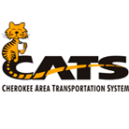
Transit Study - Purpose
Provide detailed assessment of CATS
System routing
Service types offered
Operational effectiveness
Financial sustainability
Provide recommendations that best address needs and priorities
10 Year Sustainable Implementation Plan
Long range countywide CATS vision
Accommodating Changes
Funding changes at the Federal and State level
County becoming more urban / less rural

Slide 39
Existing Services
CATS:
2 Fixed Routes in Canton
Hourly service, 8:00 AM-4:00 PM
Public countywide demand response
9:00 AM-1:00 PM
Contracted Services
Cherokee Training Center
Cherokee Senior Center
DHS
GRTA
Route 490: Canton / Woodstock → Downtown
Route 491: Woodstock to Midtown

Slide 40
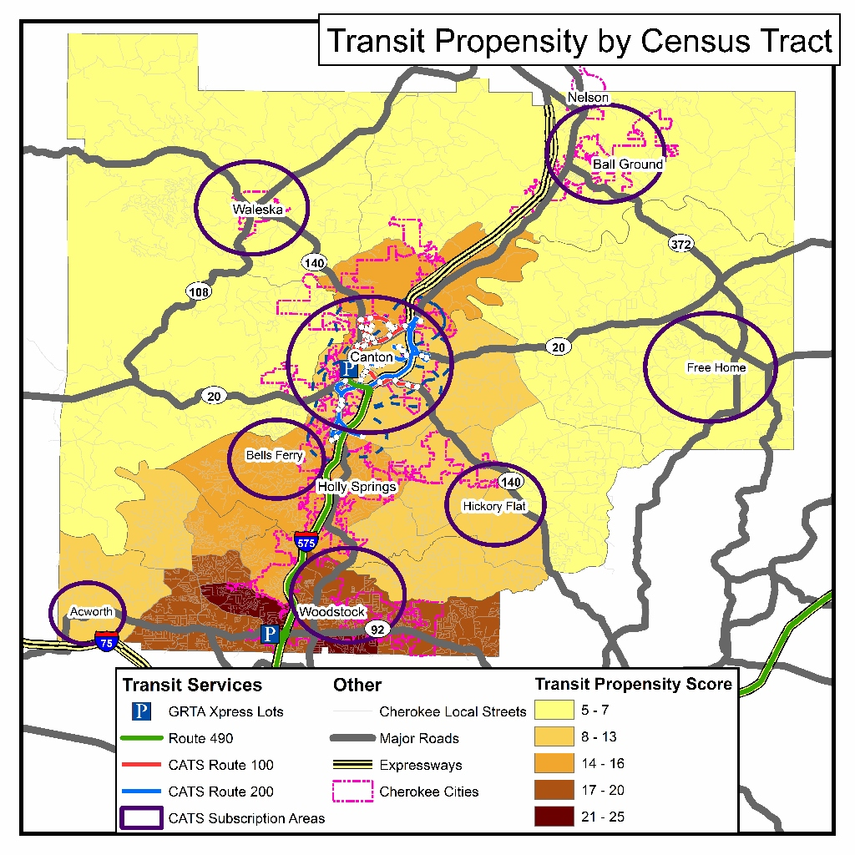
Summary of Transit Needs
Increased services in Woodstock
Connection between Canton, Holly Springs, and Woodstock
Transit connections across county lines
Regional fare/transfer interconnectivity
Improved real-time customer information
Improved stop amenities
Increase choice ridership
Additional operating funding sources
Additional capital funding sources
Notes:
Need a discussion of Transit Propensity – what is it?

Slide 41
Transit Scenarios
Factors | Scenario 1 No Change | Scenario 2 Moderate Investment | Scenario 3 High Investment
Service Levels
Increased fixed Route Service Hours
Increased number of demand response vehicles
Increased number of stops with amenities
Connecting Destinations
New flex route area in Woodstock
City connection service, Fixed route Woodstock, Holly Springs, Canton
Technology
Real time location technology
New fare technologies

Slide 42
Recommendations
Scenario 2 - Moderate Investment Scenario
Services include: New Flex Route in Woodstock Increase demand response fleet by 3 3 New bus shelters Participation in the regional OneBusAway real-time mobile application and bus stop signage program
13% Increase in local investment over the Base Scenario, but:
Nearly doubles service area
Doubles the number of low income households within ½ mile of transit
Maximizes the use of outside funding sources (80%)
Notes:
If there needs to be a compromise between the base and moderate scenarios, it is recommended that the extended service hours for the Canton shuttle be removed. This will slightly reduce the VRH, but it will also reduce cost and logistics. For the extended hours, additional drivers would have to be found because CATS employs its drivers only as part time employees in an effort to reduce benefit costs.
We need to state what cost is now vs increase in service. In the executive summary of the VHB report they state that the moderate investment of 13% increase ends up with almost doubling the service area and maximize outside revenue sources – this needs to be pointed out. - Addressed
Do we need last 2 bullets? Can they be expanded? - Addressed

Slide 43
Leveraged Funds
Notes:
Good place to note the increase amount of County cost between scenarios.

Slide 44
Cherokee County Local Contribution
Notes:
Takeaways:
Regardless, Cherokee will have to increase it’s local funding for CATS.
The higher amount of service qualifies CATS for more funds, still increasing costs, but providing more service per County dollar spent.
Costs are for years with all services. There will be a gradual increase as services are implemented over 3 years
its transfer from the general fund to continue transit services at the same or increased leveScenario
Cherokee Annual Contribution
Current
$200,000
Base Scenario
$255,010
Moderate Investment Scenario
$303,080
High Investment Scenario
$360,420

Slide 45
Where could the additional local funds come from?
SPLOST funds cannot be spent on operations, but using them for regular capital costs would reduce the requested amount from the general fund.
Increase in cost to County for recommendations: $102,500
Strategy | Potential Annual Savings
Use SPLOST Funds for Matching Federal Dollars for Capital Expenditures | $66,500
Increasing Fixed/Flex Route Fares | $6,200
Increasing Demand Response Fares | $2,850
CNG Buses | $40,000
Contributions from Cities | $20,000
POTENTIAL ANNUAL TOTAL SAVINGS | $135,550
While this would require up front capital costs, SPLOST funds could be used, whereas they cannot be spend on operations.
This assumes $10,000 each year from Canton and Woodstock for illustrative purposes. However, a number could be worked out with cities.
A combination of these strategies, could potentially
make up completely
the increase in costs for the County.

Slide 46
Implementation Plan
Anticipated Implementation Plan
Project | Implementation
New Flex Route | FY 2016: Marketing and Detailed Plans
 | FY 2017: Procure Vehicles, install fixed stops, and hire additional drivers
 | FY 2018: Begin service
Additional Demand Response Vehicles | One additional vehicle each FY: 2016, 2017, 2018
New Bus Shelters | FY 2016: 1 new shelter along Canton Routes
 | FY 2017: 2 new shelters at fixed stops in Woodstock
OneBusAway App & Stop Signs | FY 2016
Potential Add-On Project | Implementation
Voucher Program | FY 2016 or FY 2017 based on capital funding availability
Cobb connection across county lines | FY 2016: Coordinate with MARTA and CCT, using the MARTA-CCT agreement as starting point

Slide 47
Policy Considerations
Access Management Guidelines
Complete Streets Policy
Transportation Demand Management

Slide 48
Next Steps
Finalize Plan
Adoption by Cherokee County Board of Commissioners Board on February 2
Begin Programming & Delivering Projects!

Slide 49
Questions?
Cherokee County:
Geoffrey E. Morton, PE
Public Works Agency Director
(678) 493-6077
gmorton@cherokeega.com
WSP | Parsons Brinckerhoff:
Claudia Bilotto, AICP
(404) 364-2651
bilottocm@pbworld.com
Notes:
We may want to add a funding summary slide for each tier and for each year that shows current needs vs current investment on County SPLOST projects and State and Federal funded projects. We have a dollars and cents BOC.

